Slide 1
Insight
Collect clock shards to active the chrono machine to escape a maze of disorder and horror...别忘记设计logo字体，建议用齿轮，钢管拼26个字母
Game Design & Develop: Wu Yi

Slide 2
目 录
01
Overview
Introduction
Art style
Play though
CONTENTS
02
Design
Game mechanics
Highlight Spots
Level Design
03
Assets
Models · Materials
Animations · Props · VFX
Logo · Font · Misc
04
Reference
Innovation sources

Slide 3

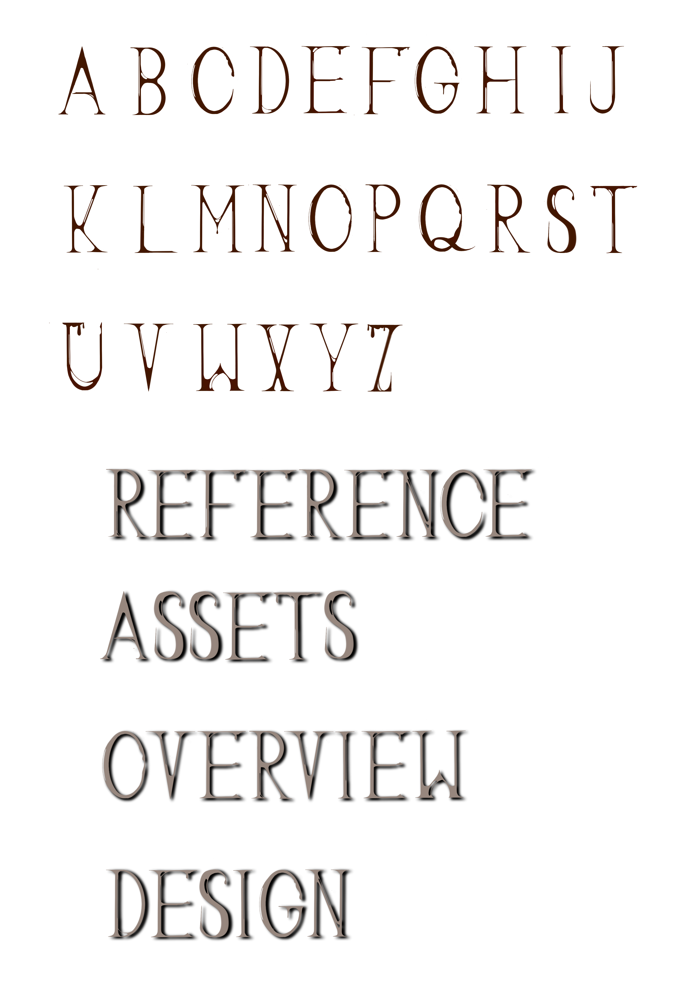
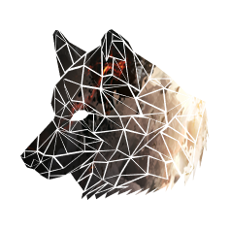

Slide 4
Introduction
This is a single person puzzle game.
Game and walkthough video available at www.itch.io/wuyi.
Camera: 3rd person view, camera follows character
Control: Walk, Run
Dev Tool: Unreal Engine + Maya + Blender

Slide 5
Art Style
Here are the main art styles used in this game with ref link.
Most common:
Victorian Art
Steam Punk
Rare but still important:
Gothic Style
Cthulhu
You can also go to the reference part(page 20) to see more detailed art style references.

Slide 6
Playthough
The player controls a person to explore in a small maze. The objectif is to collect all shards to active the clock.
The maze is small but a little tricky, it has multi-layer structure with hidden paths though the “depth” axis. The player must take advantage of camera control to find out where and how to collect items.
For each shard collected, an animation will be played and one part with be add to the chrono machine. When all shards collected. The chrono machine will be activated and the game is complete.

Slide 8
Game Mechanics
To implement some interesting gameplay while not to learn too deep into Coding & Blueprint. I choosed to use very limited mechanics + rich level design, so that I would have less feature to develop.
In the end all mechanics are implemented by Blueprints.

Slide 9
Character & Camera Control
Thanks to Unreal Engine. I used the build-in character controller.
The character controller’s attributes such as speed, walking height tolerance are well adjusted to fit the gameplay.
Some of the character controller’s function such as jump are disabled.

Slide 10
Clock Anime
Clock rotate animation as well as related camera scenario animation are all implemented by blueprints
After we collect a shard. the following things happen: Camera switch->clock part show anime->VFX show->rotate->camera switch

Slide 11
Collect
We can collect items by reach the item
Once Collected, play a camera fov animation then switch camera view

Slide 12
Interactive environment
These eyes will always focus on you!
These faces will reactive when you appear!
Candles and other dynamic props.

Slide 14
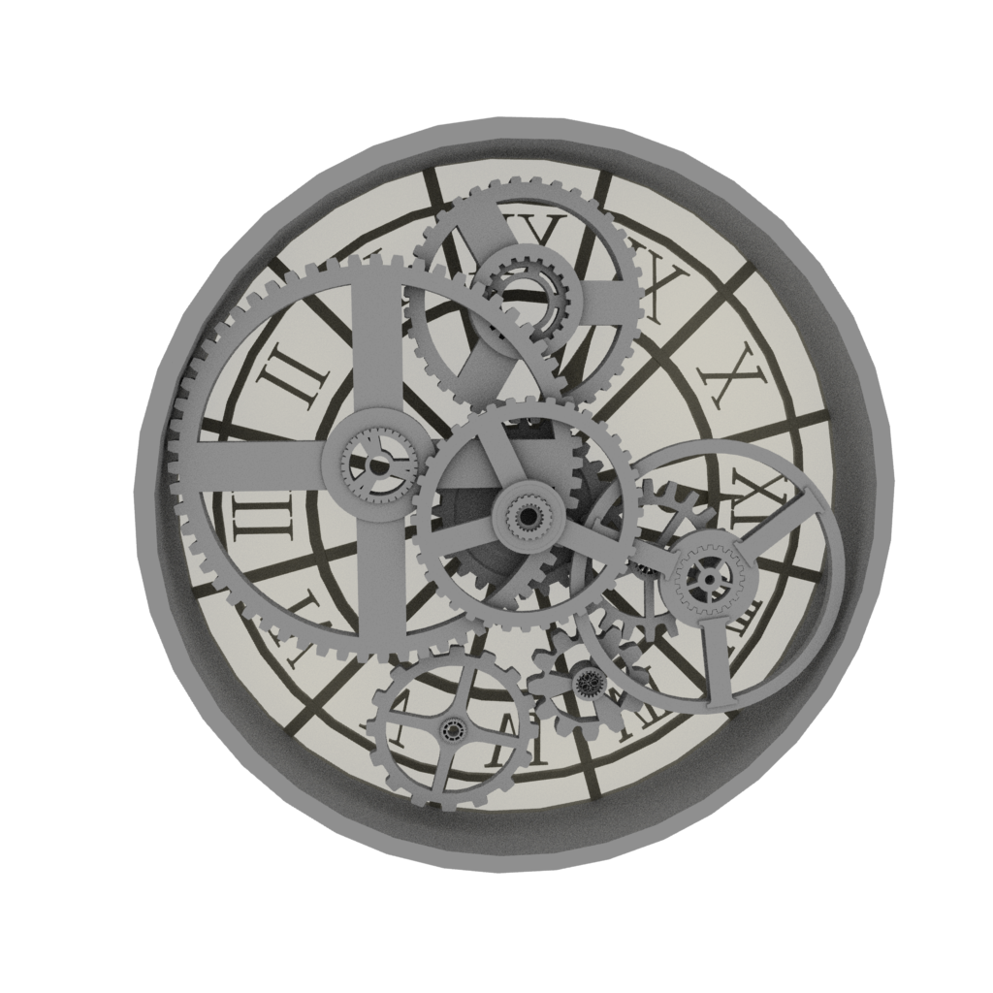
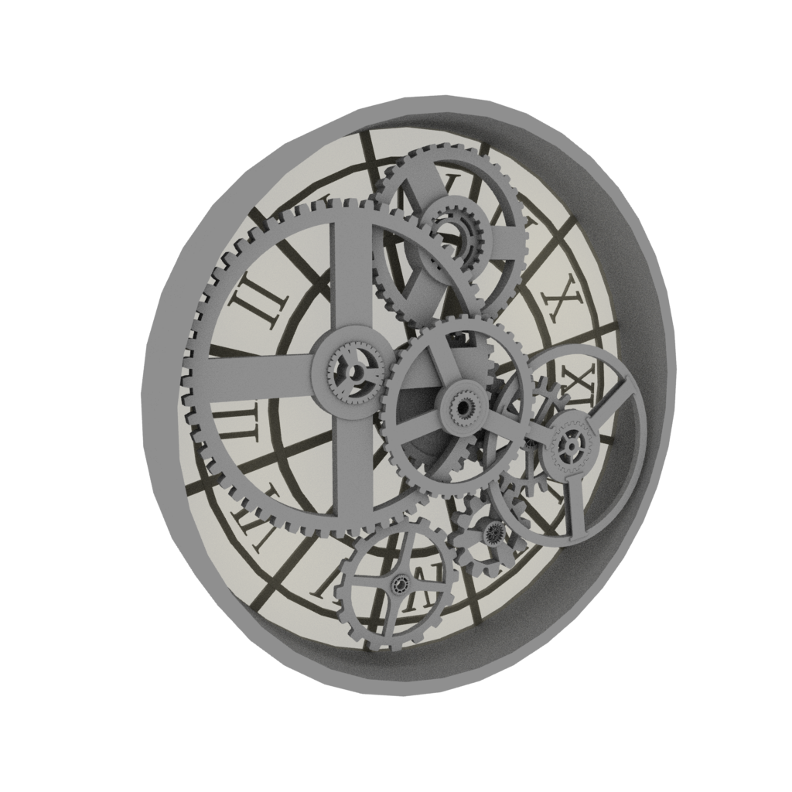
Models-Clock
The principle object of the scene.

Slide 15
Moodboard

Slide 16
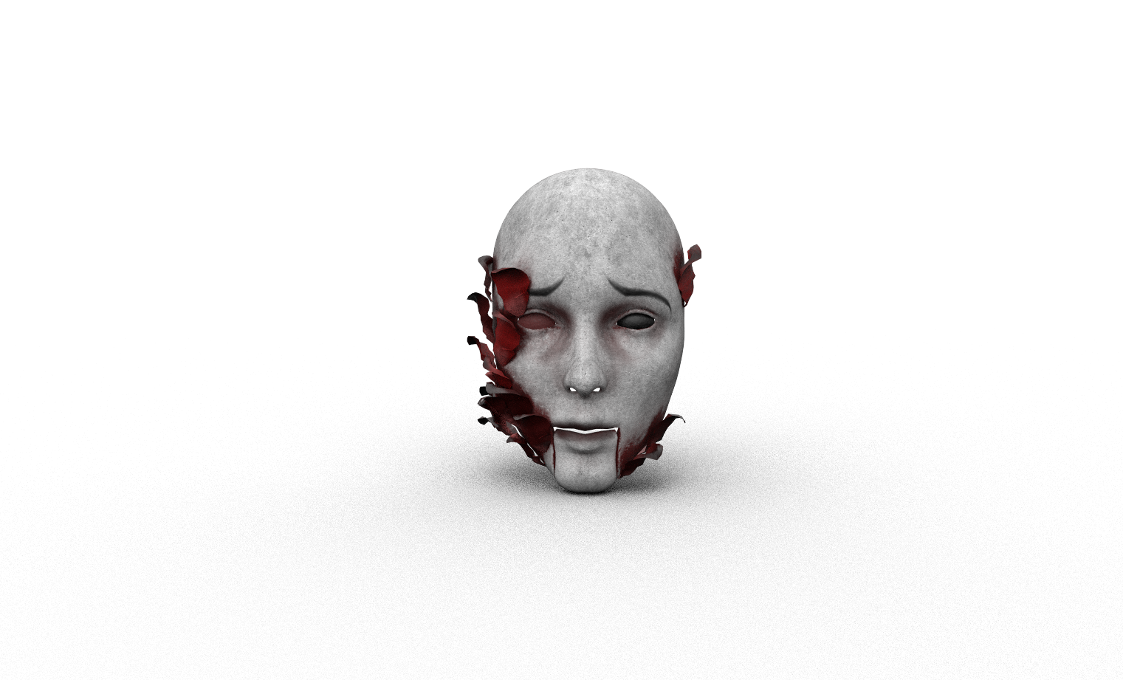
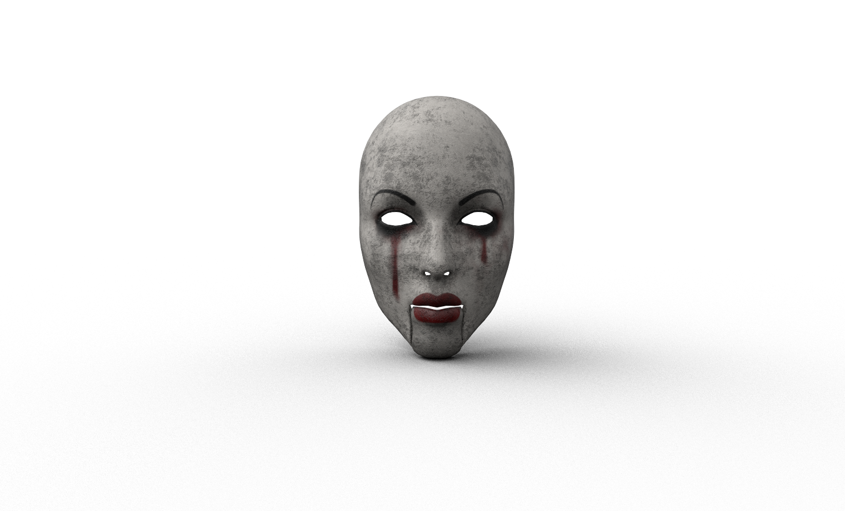
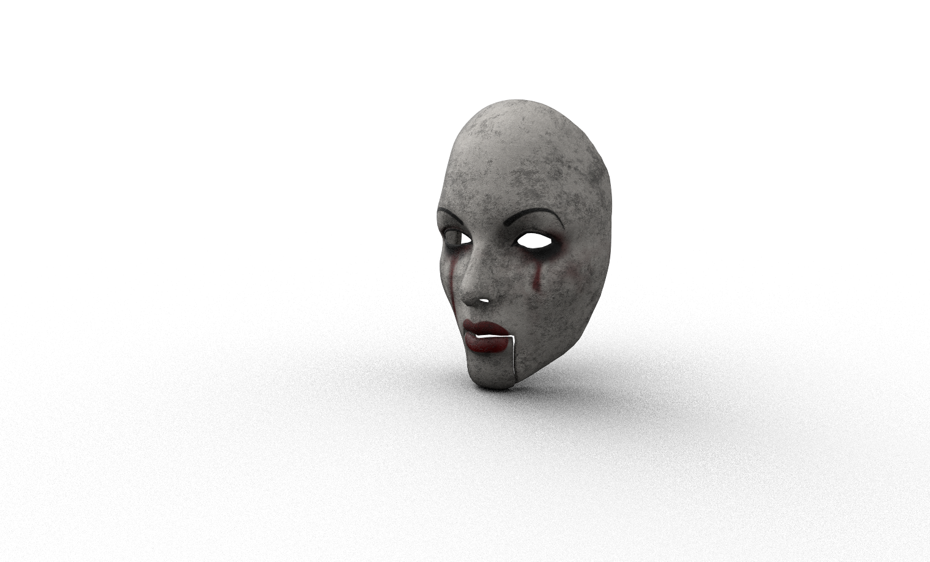
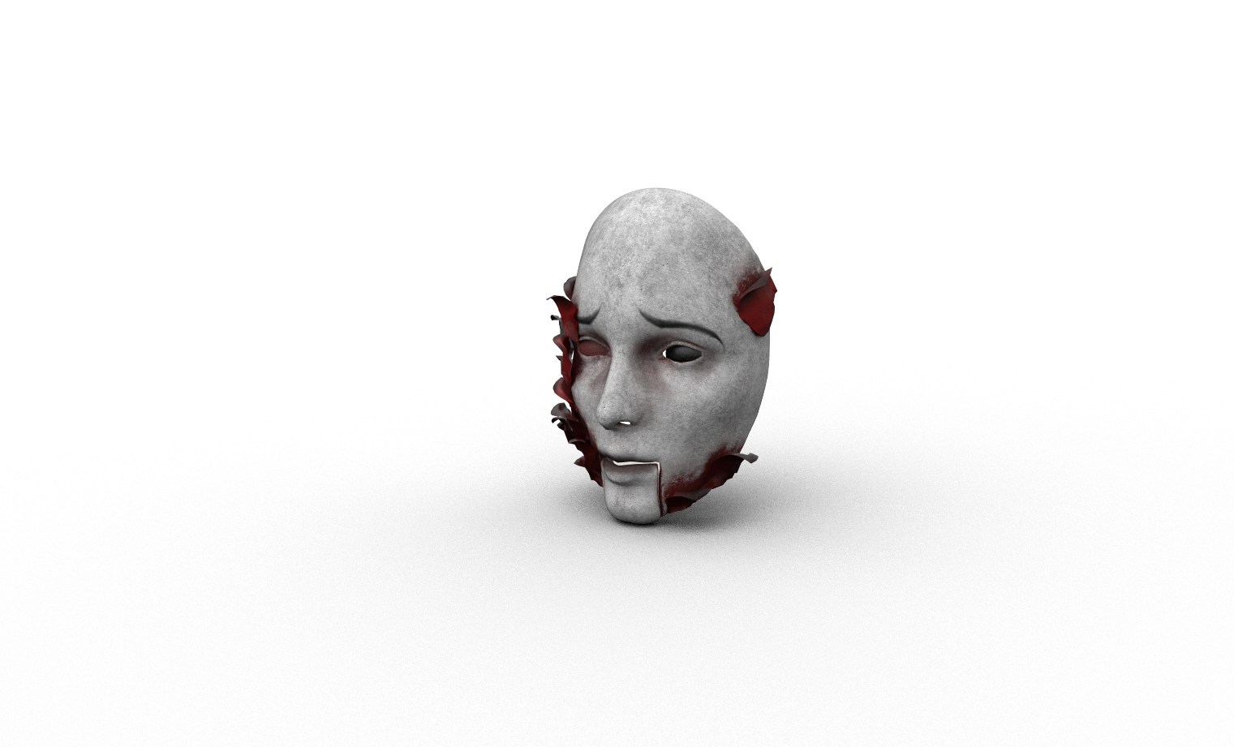
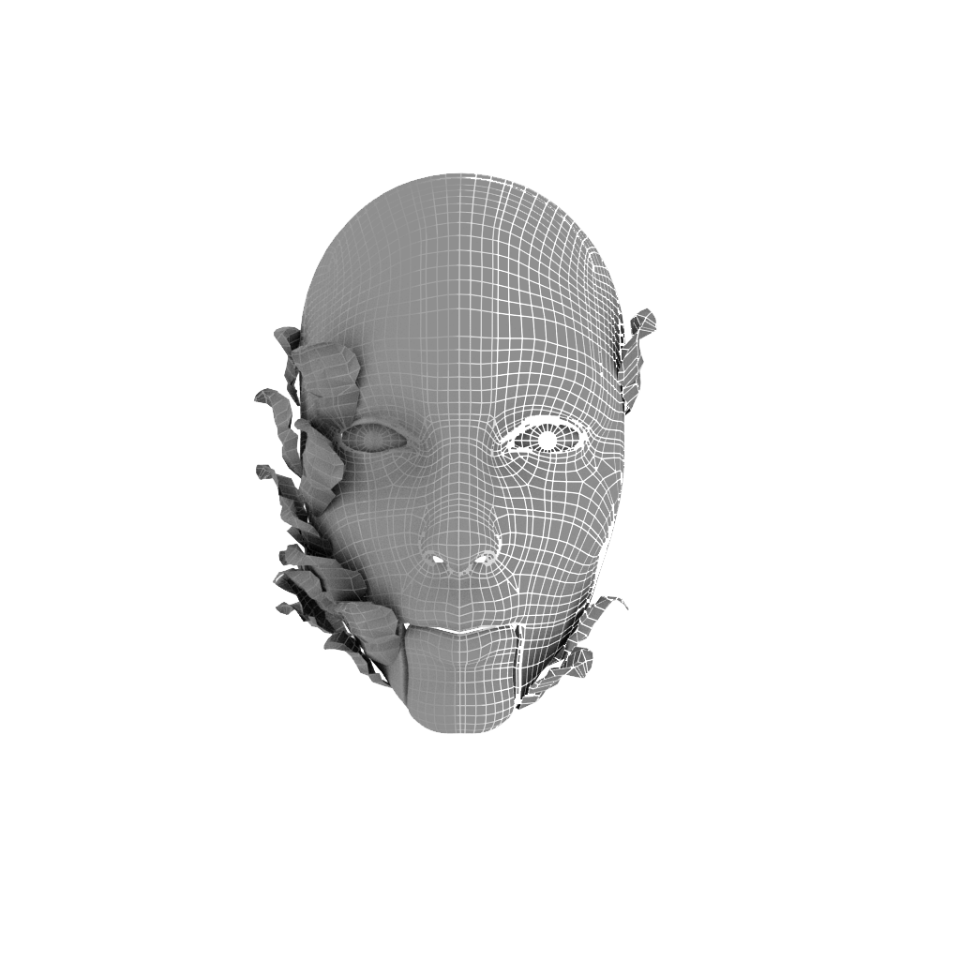
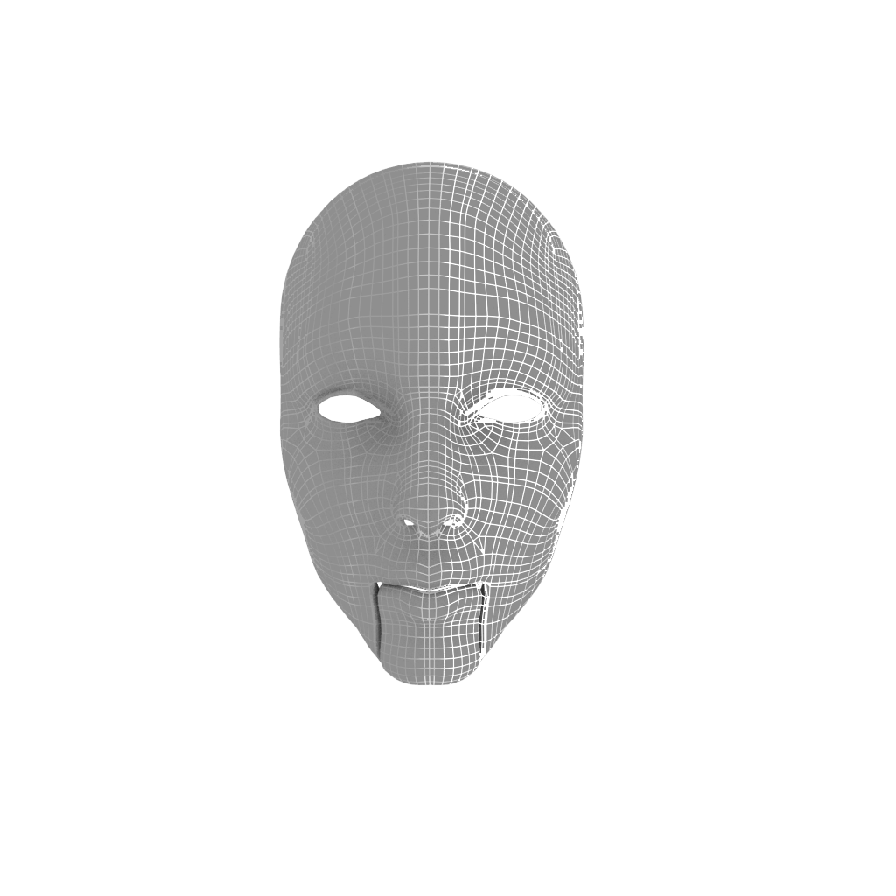
Models-Masks
Masks or faces create scary ambience for the game and animates when come close

Slide 17
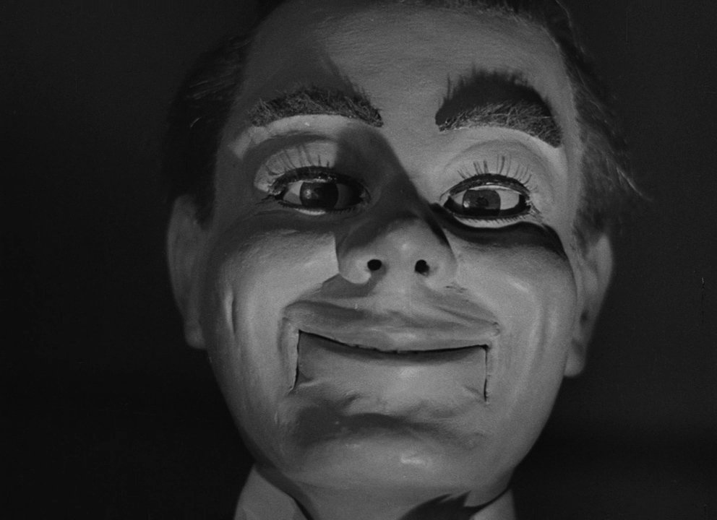
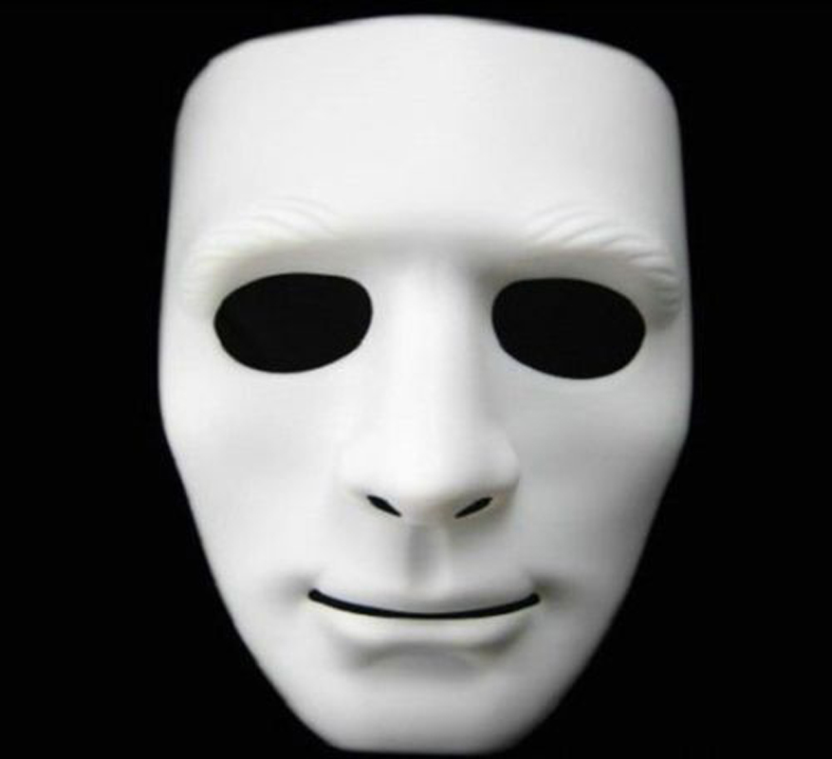

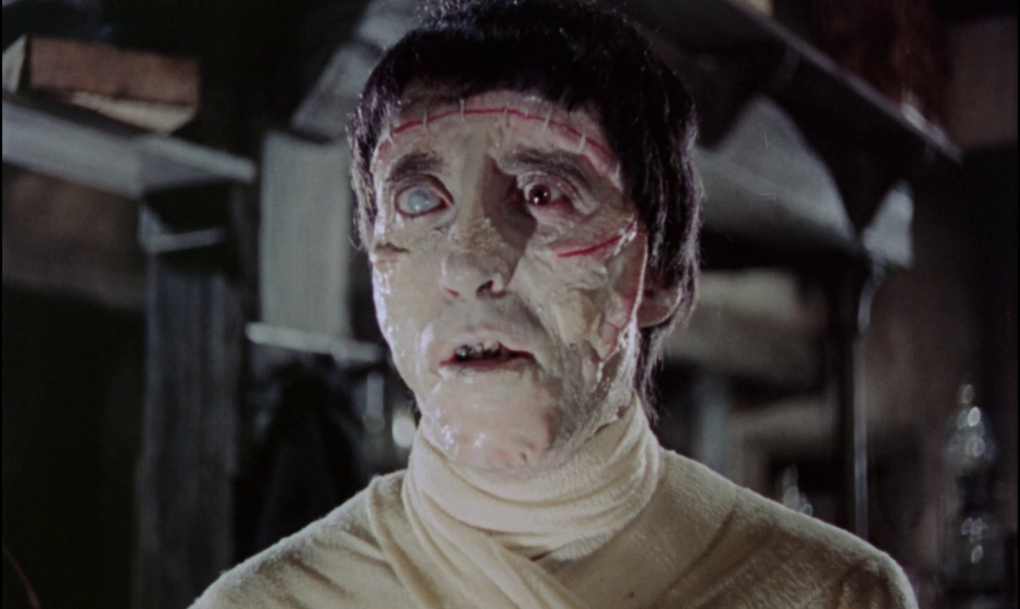
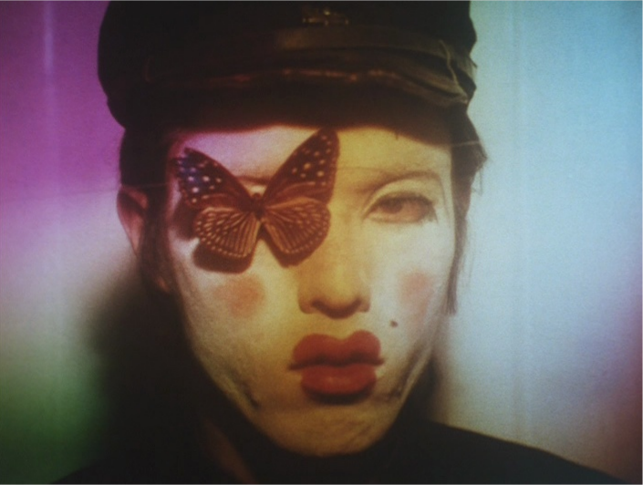
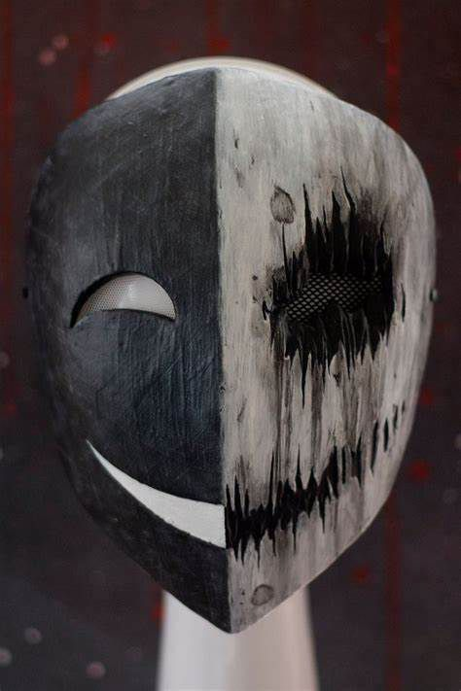
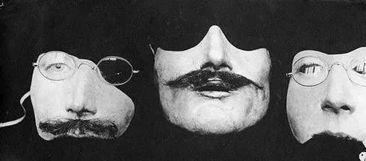
Moodboard

Slide 18
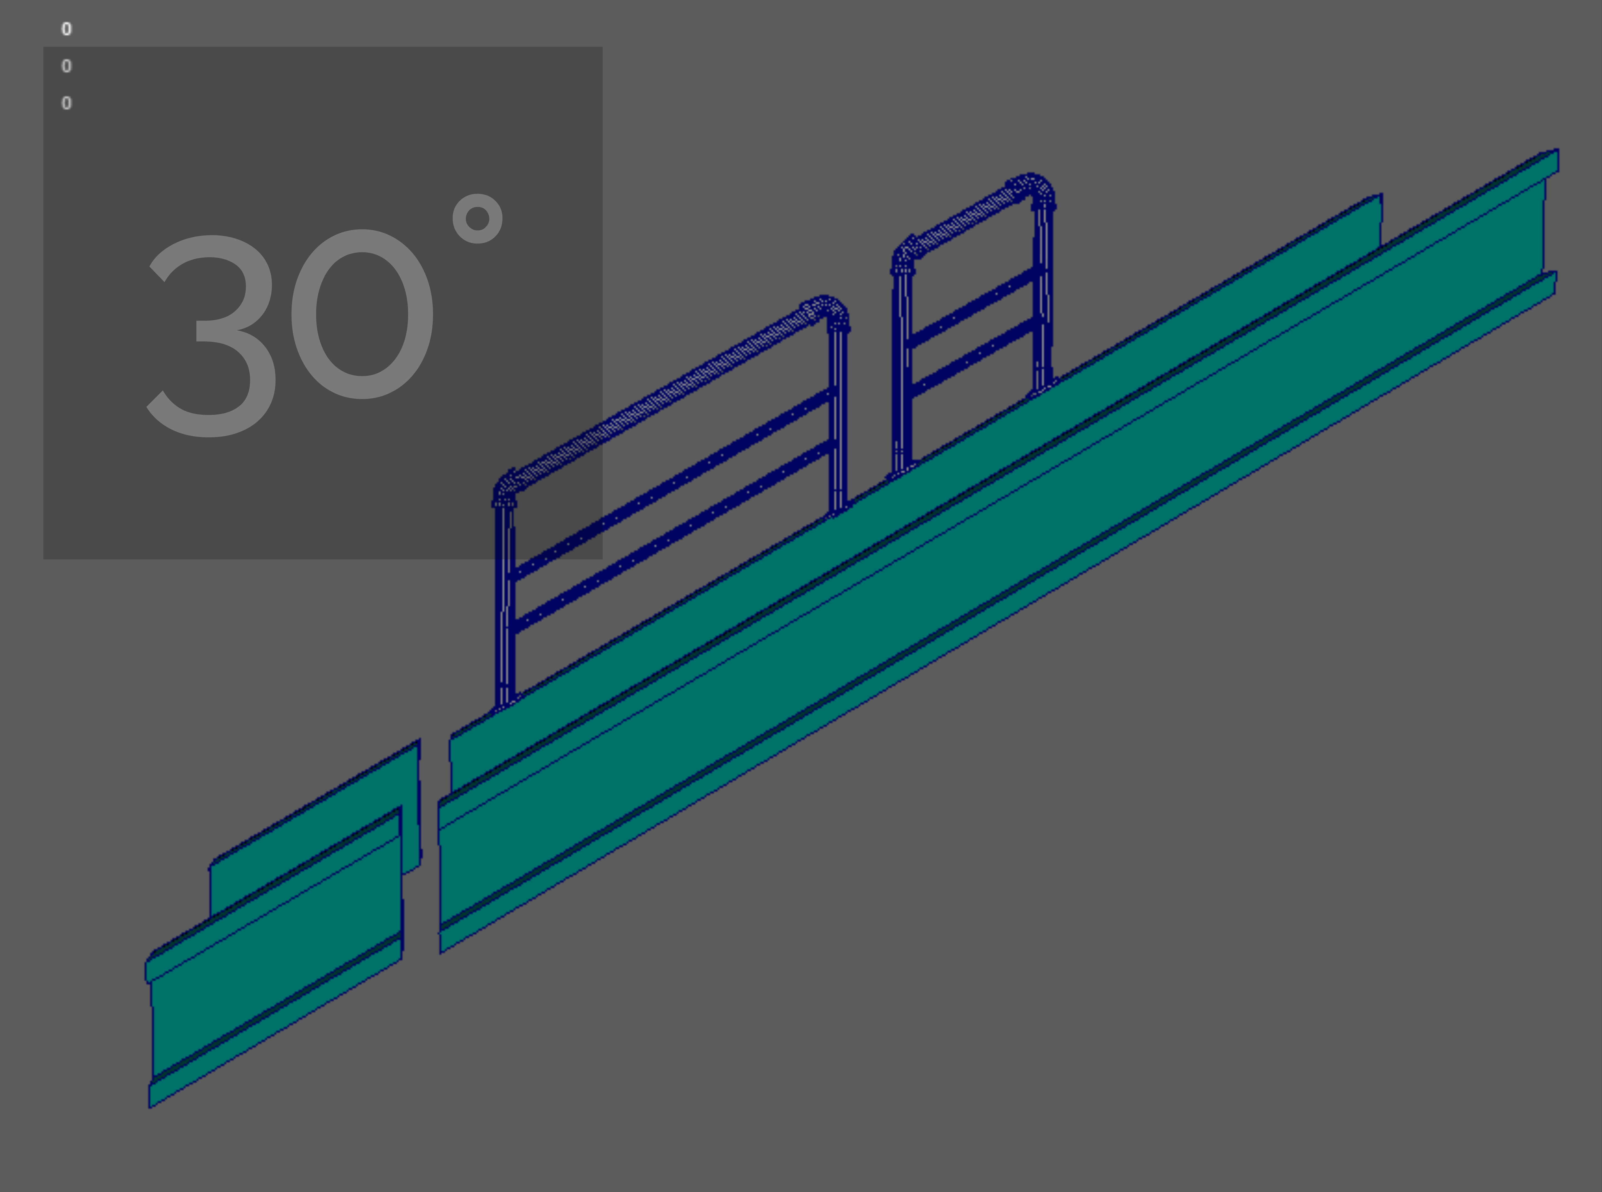
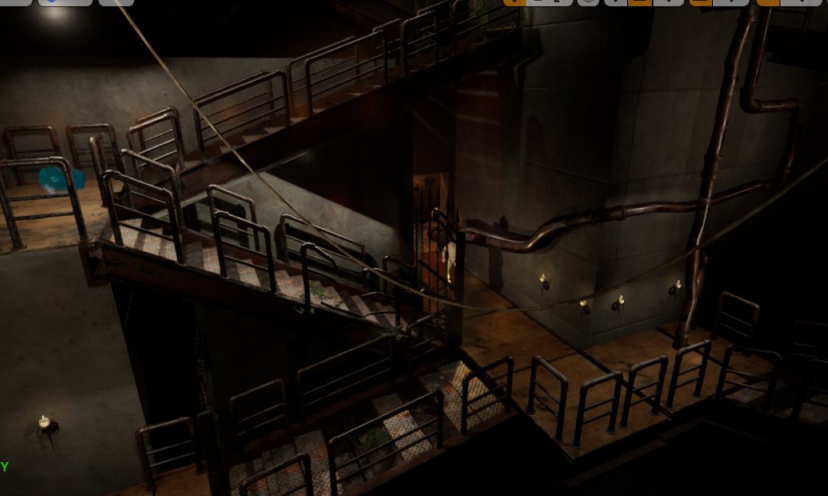
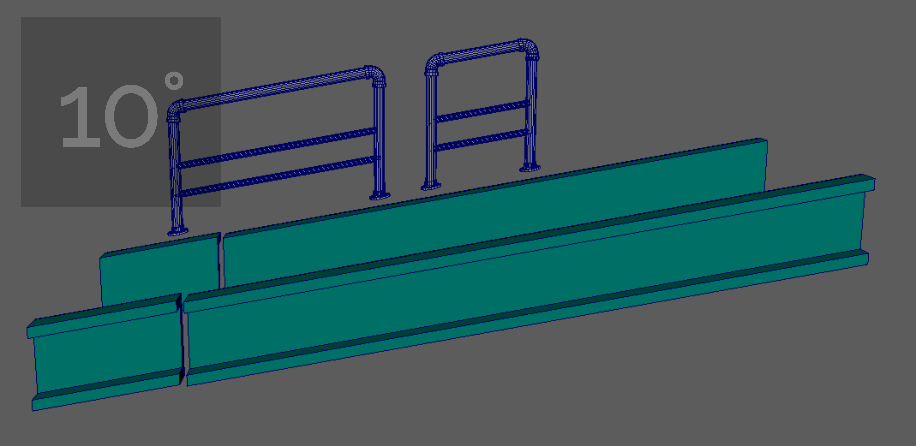
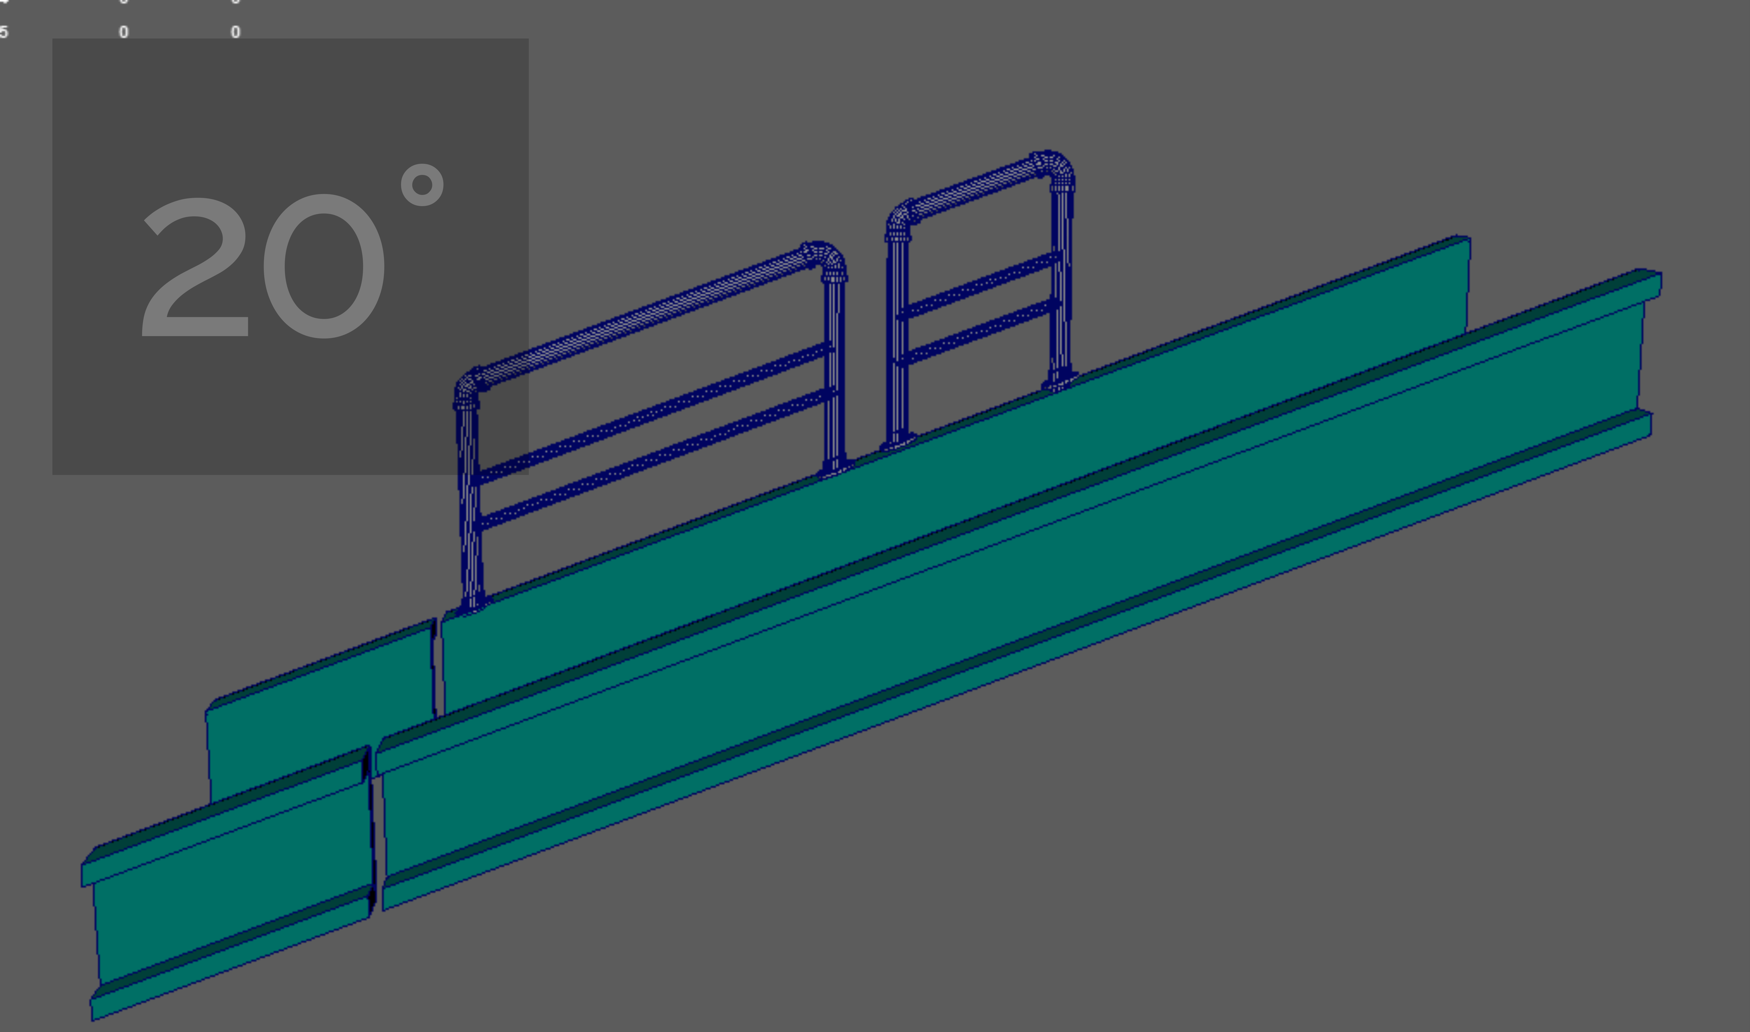
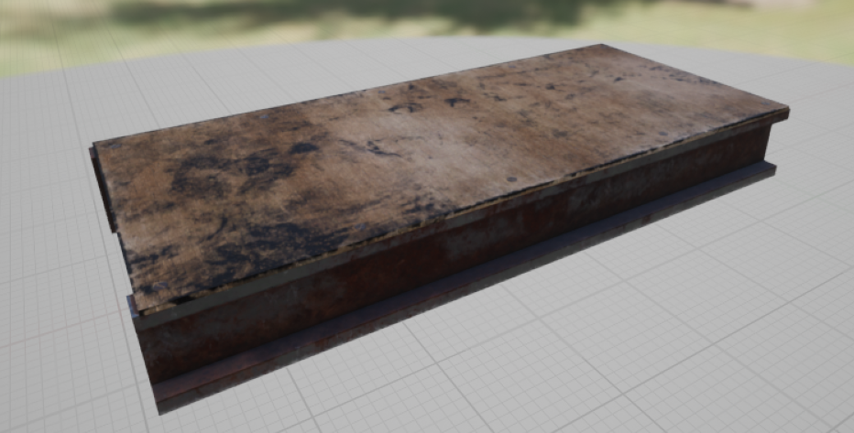
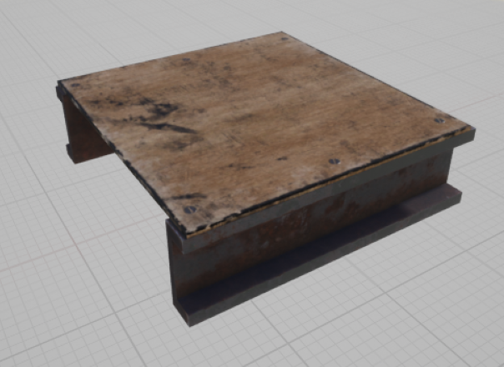
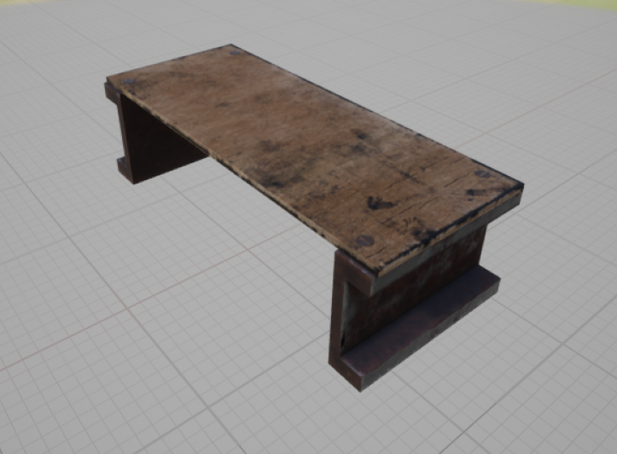
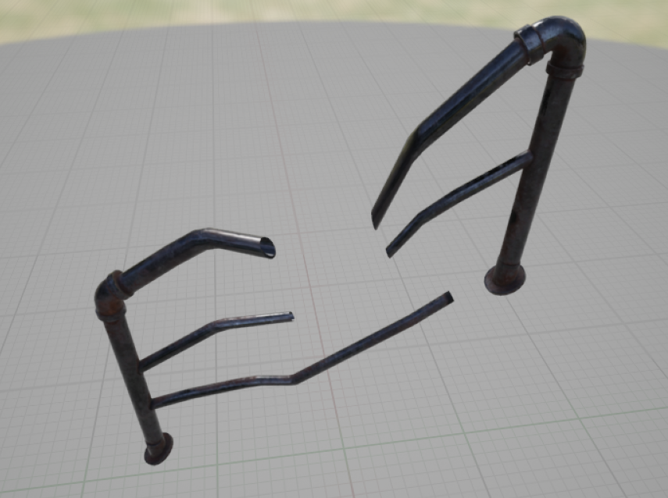
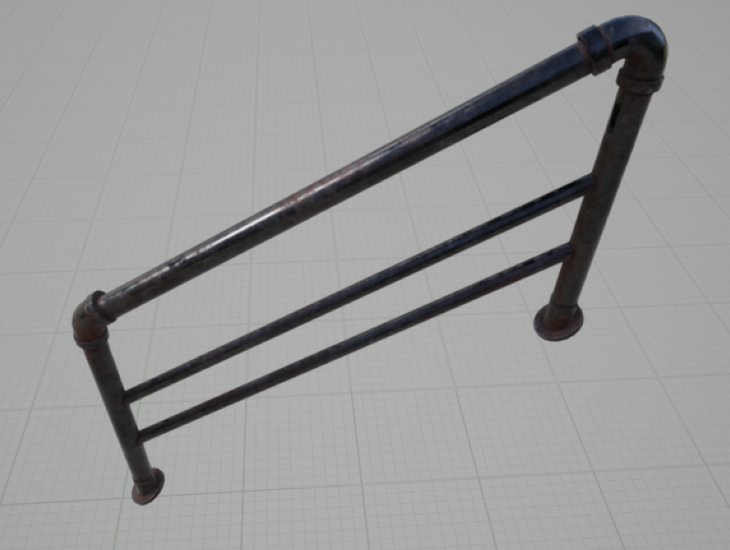
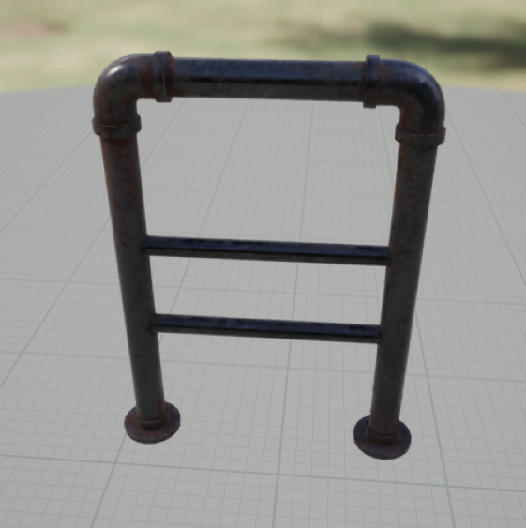
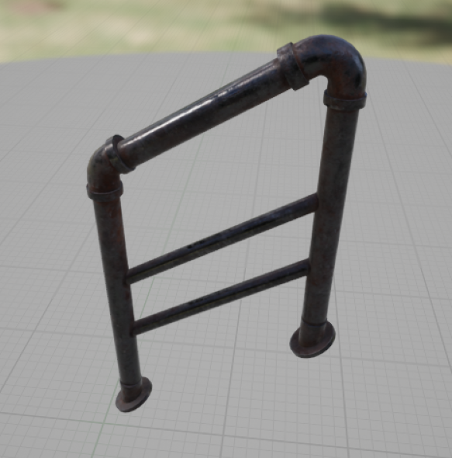
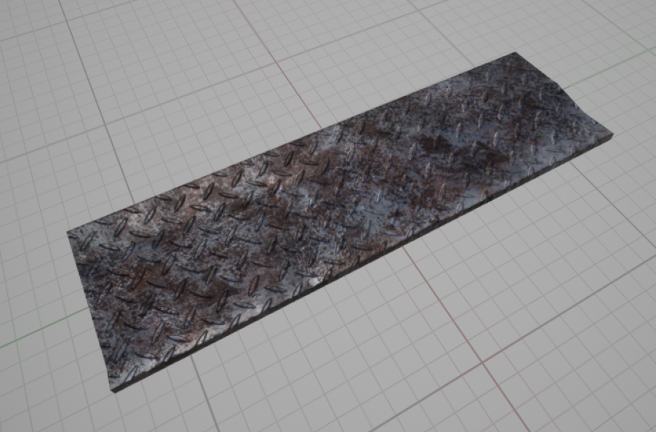
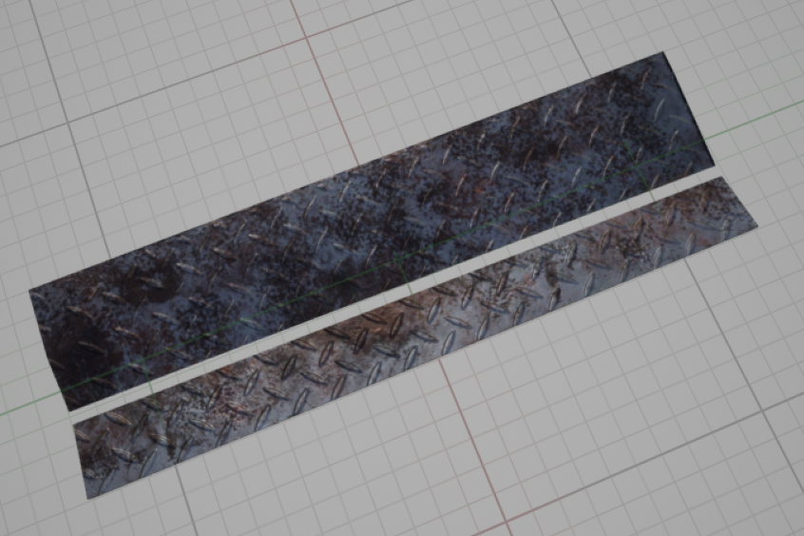
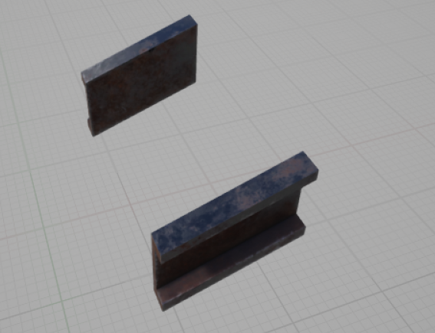
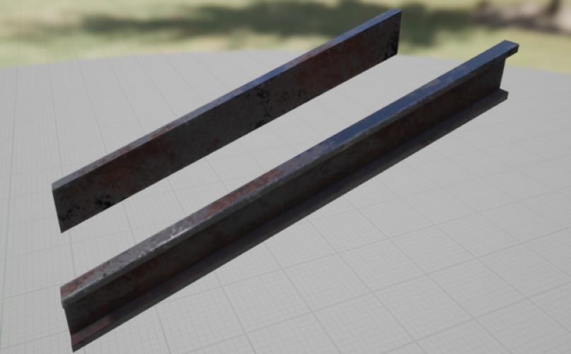
Models-Building
floors & walls & stairs

Slide 19
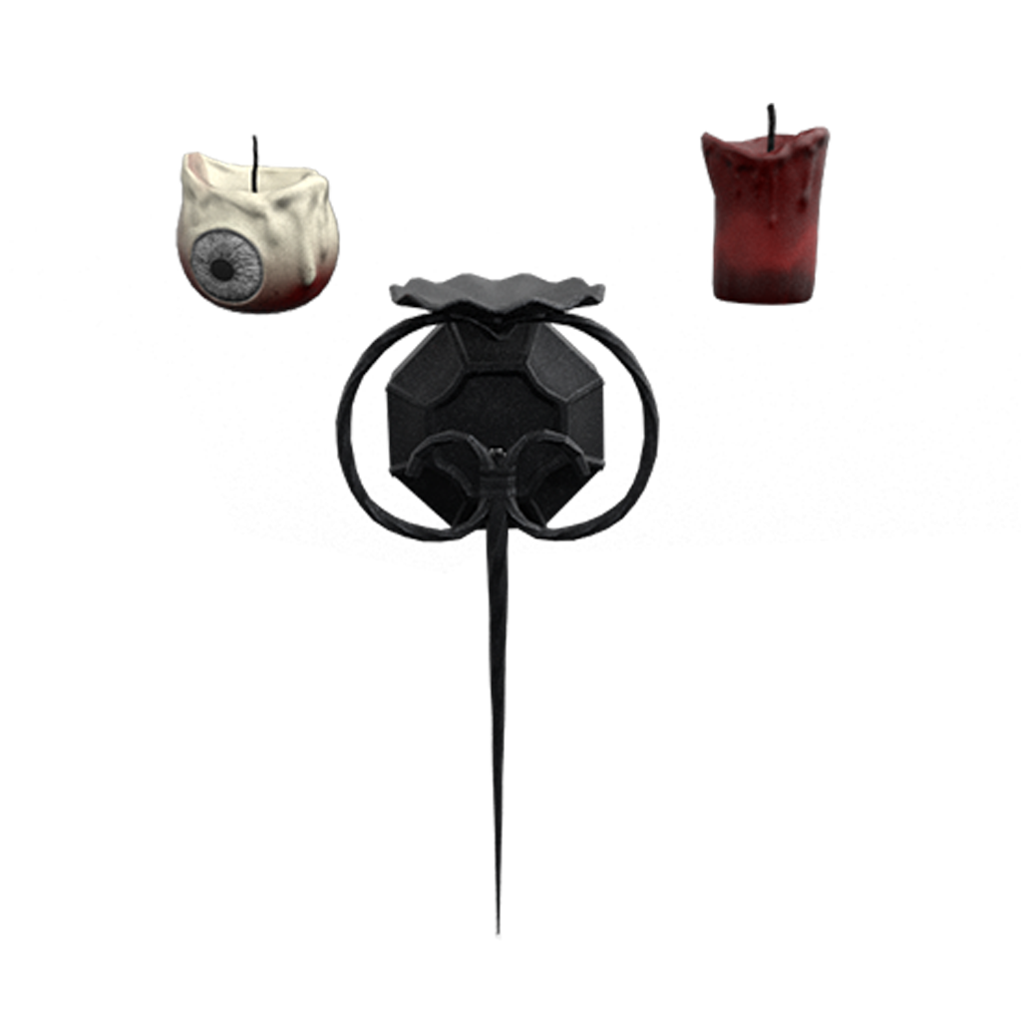
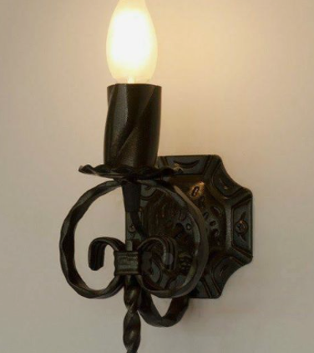
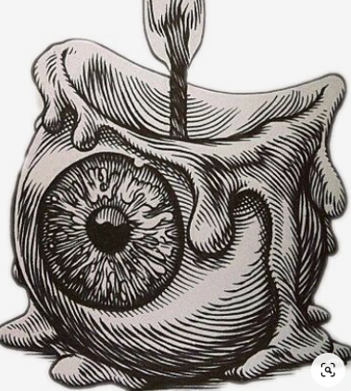
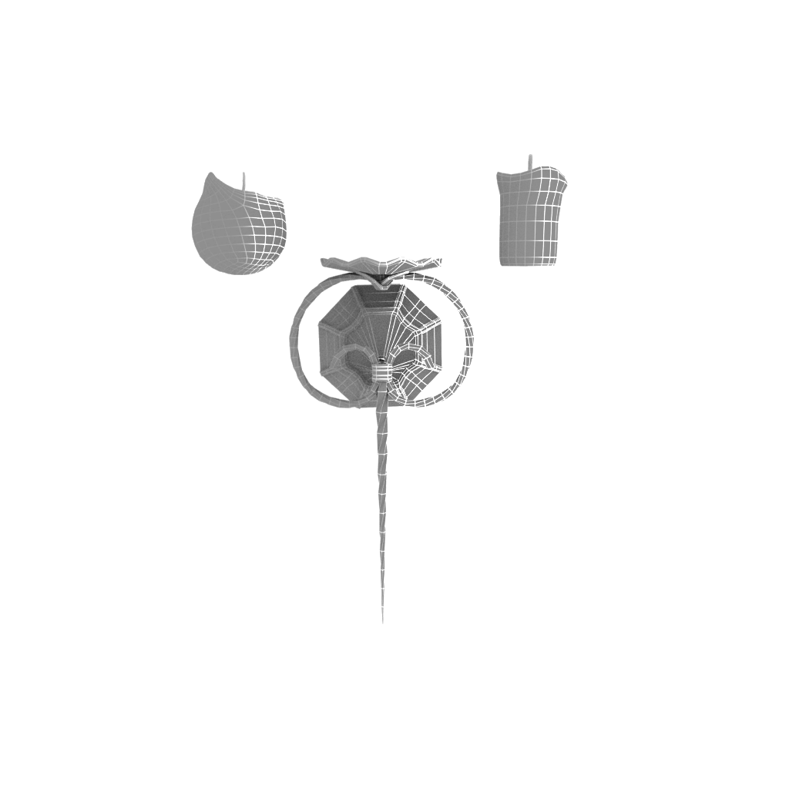
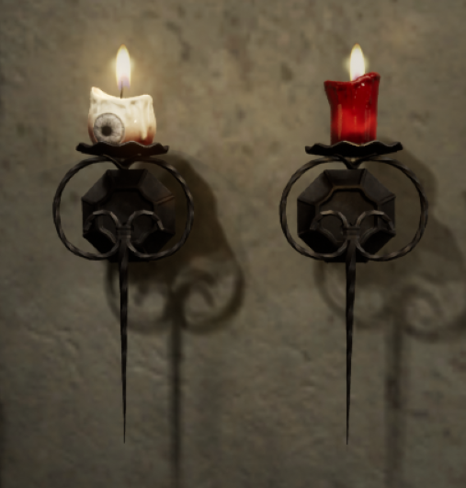
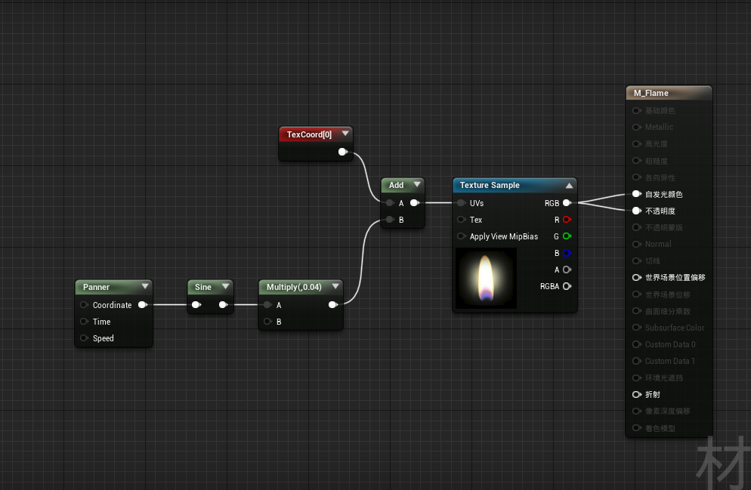
Models-Candle

Slide 20
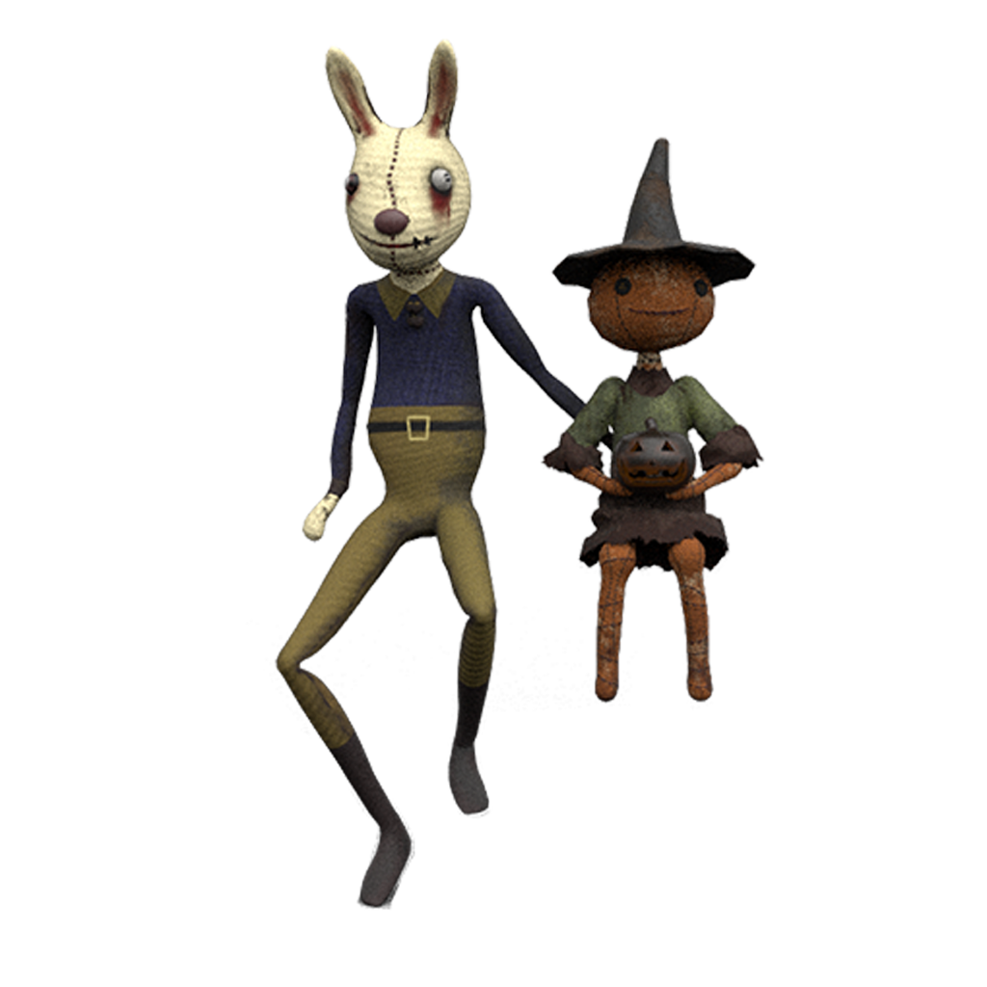
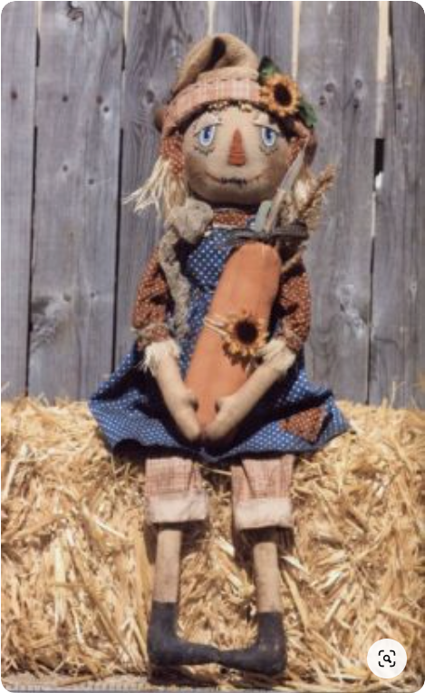
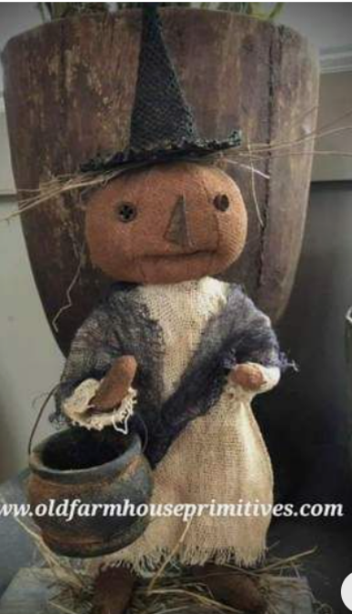
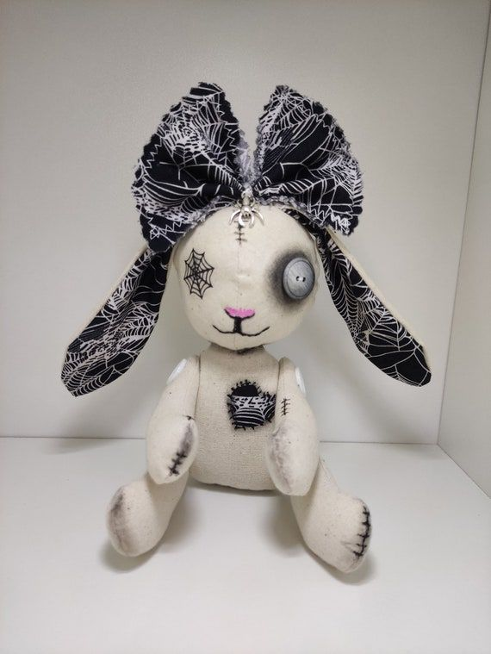
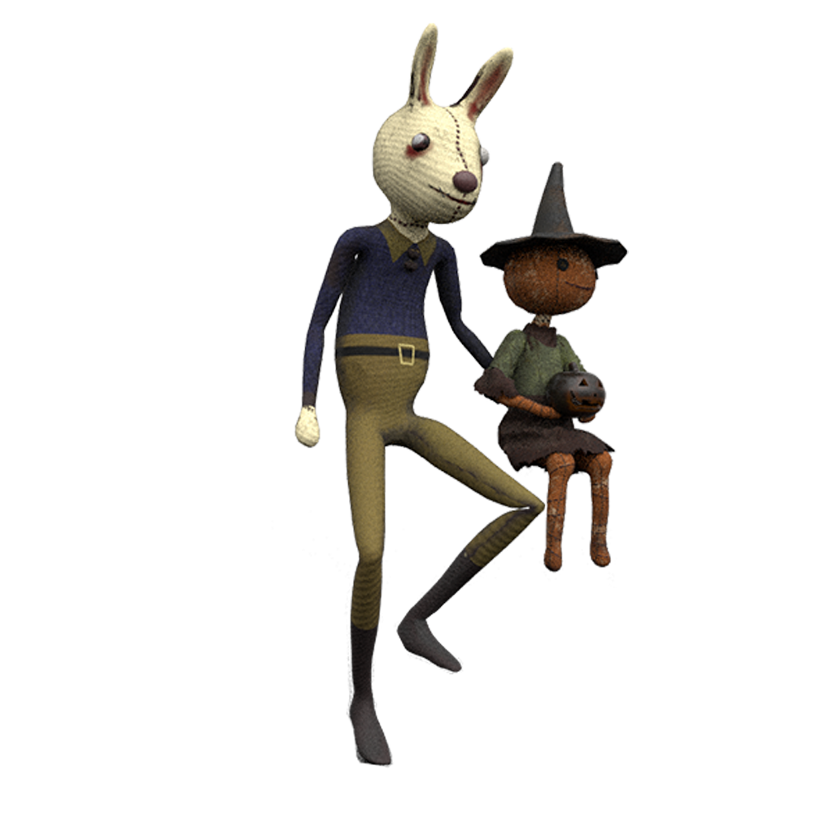
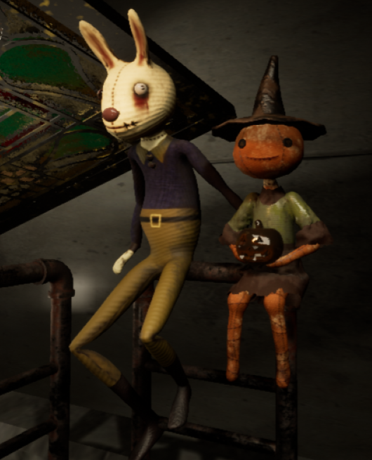
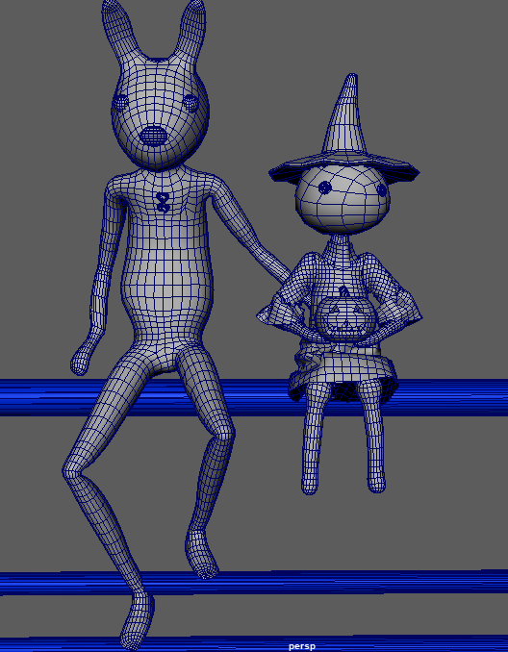
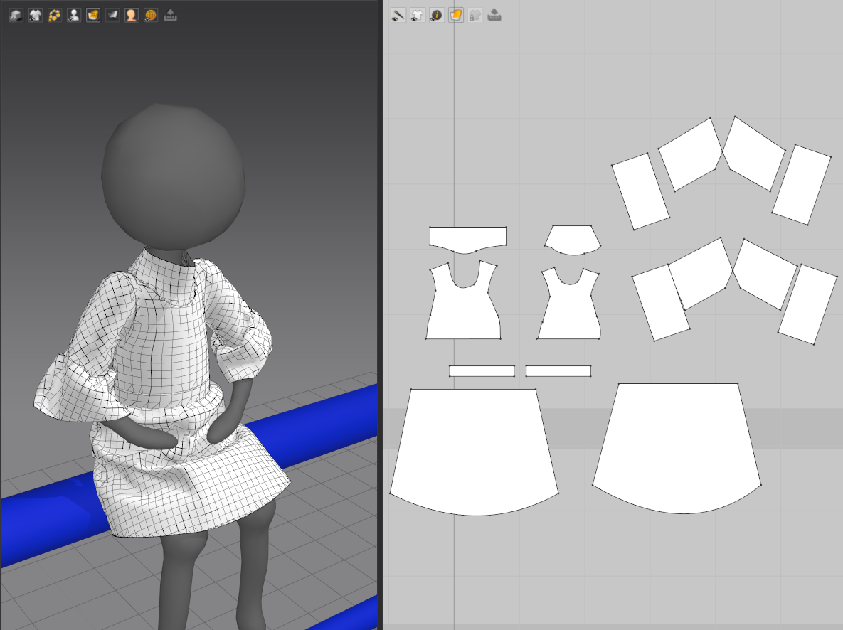
Model

Slide 21
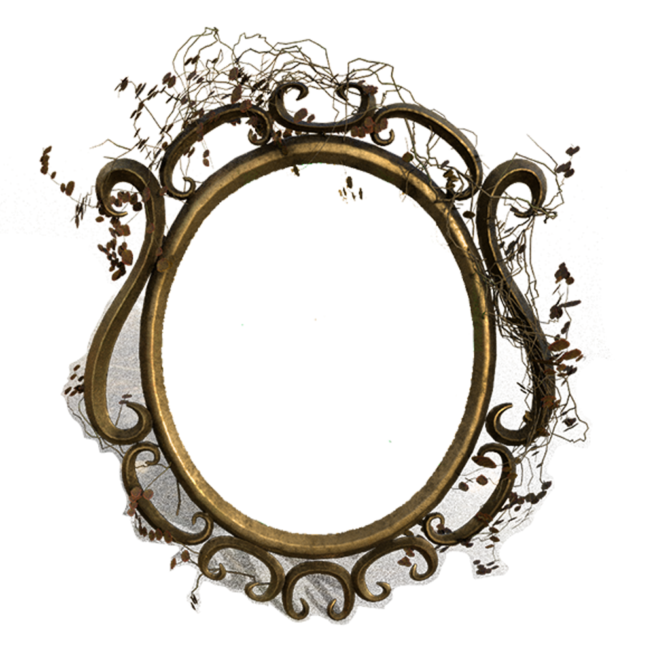
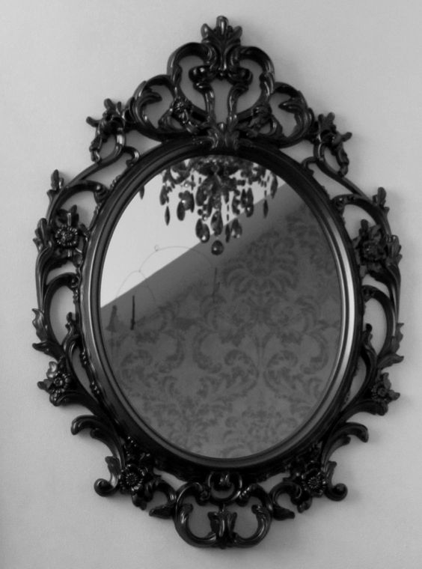
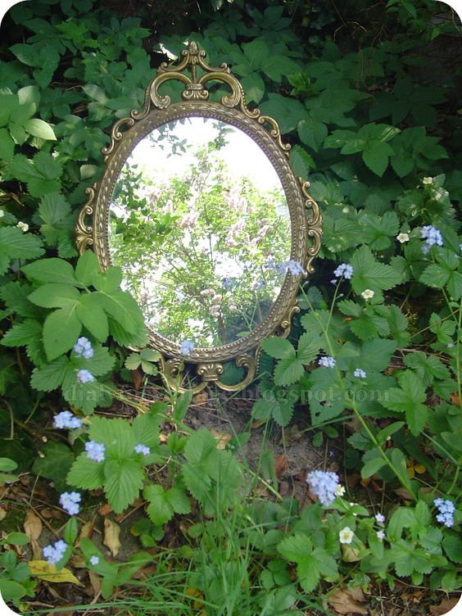
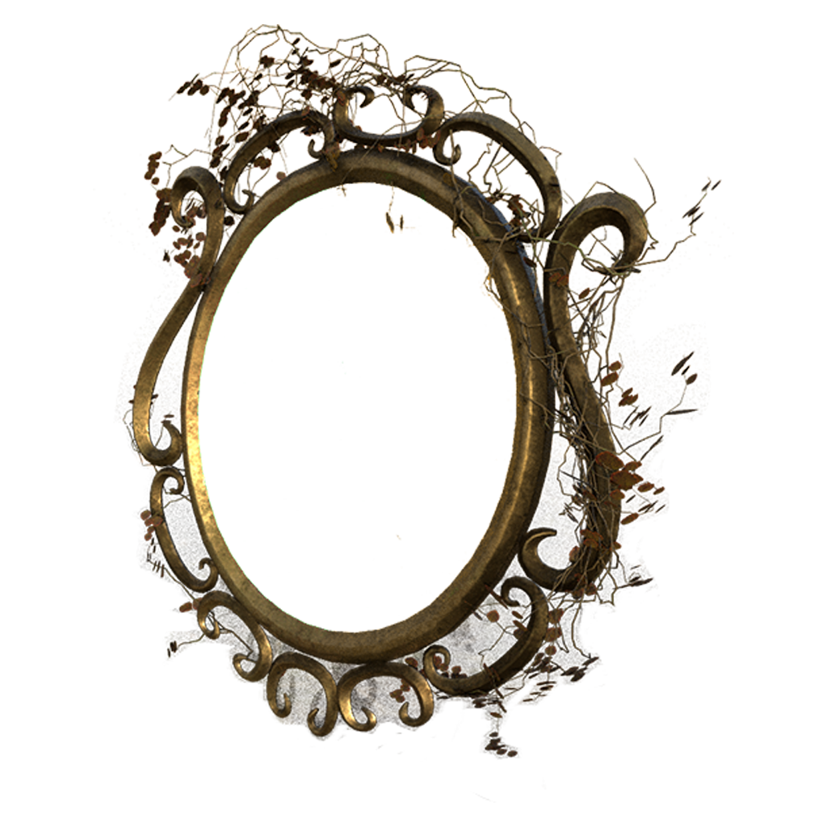
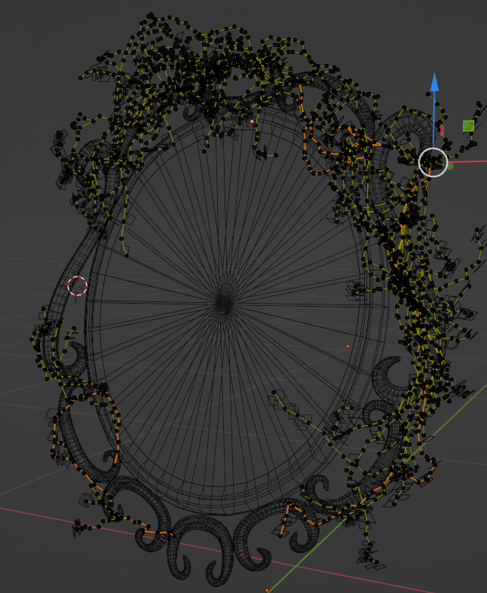

Model

Slide 22




Model

Slide 23






Model-Character

Slide 24






Moodboard

Slide 25
Materials
based on build-in materials, I created those materials:
metals
colorful glass window
transparent shiny phantom
etc...

Slide 26
Logo

Slide 27

Font

Slide 29

Game
Bloodborne
It takes two
Overall ambiance, especially itsvictorian style. And also the clock syle in the DLC
The clock scene and some material feelings.
Machinarium
Steam punk style. And the color theme.

Slide 30
Animation
某某
给了什么方面的参考作用

